Slide 1

Accelerate Drug Discovery using ai model

Slide 2
Introduction to AI in Drug Discovery
The Transformative Potential of AI
Challenges in Drug Discovery
The AI-First Model
A Roadmap
Conclusion

Slide 3
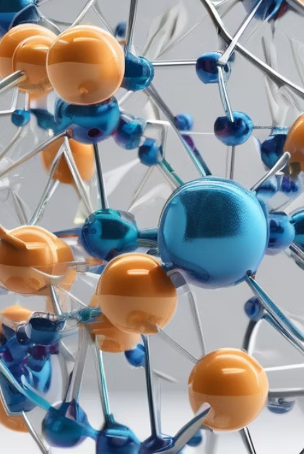
Introduction to AI in Drug Discovery
AI has the potential to revolutionize drug discovery by leveraging machine learning algorithms and big data analytics to accelerate the process of identifying and developing new therapeutics.
Impact on the Pharmaceutical Industry
AI can significantly reduce the time and cost involved in drug discovery, enabling pharmaceutical companies to bring new treatments to market faster and more efficiently.
It can also improve the accuracy and precision of drug design, leading to more effective and targeted therapies.

Slide 4
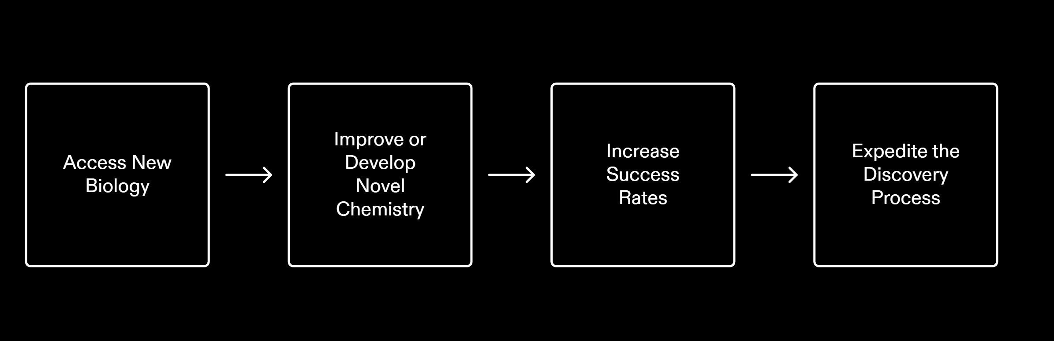
The Transformative Potential of AI
AI has the potential to revolutionize the field of drug discovery, offering new opportunities and advancements in the development of life-saving medications. By leveraging AI technologies, pharmaceutical companies can access new biology, improve or develop novel chemistry, increase success rates, and expedite the discovery process.

Slide 5
Challenges in Drug Discovery
Limited Success
Despite significant investments, the success rate of drug discovery is relatively low.
AI can improve success rates by analyzing complex biological data and identifying potential drug targets with higher precision.
Data Complexity
Drug discovery involves analyzing complex biological data, including genomics, proteomics, and chemical structures.
AI can handle and interpret this data more effectively, enabling researchers to make informed decisions.
Cost
High Cost
Drug
Drug discovery and development is an expensive process due to the need for extensive research, clinical trials, and regulatory compliance.
Help
AI can help optimize resources and identify potential drug candidates more efficiently, reducing costs.
Time
Time-Consuming
Take
The drug discovery process can take several years, from target identification to clinical trials.
Accelerate
AI can accelerate this process by analyzing vast amounts of data and predicting the effectiveness of drug candidates, saving time.

Slide 6
The AI-First Model
Pharmaceutical companies are increasingly recognizing the transformative potential of AI in drug discovery and are looking to adopt AI in their R&D processes. Here is a roadmap for pharma companies to successfully integrate AI into their operations:
Develop AI Vision and Strategy
Pharma companies should start by defining their AI vision and strategy. This involves identifying the areas where AI can have the most impact and aligning AI initiatives with overall business goals. It is important to have a clear roadmap and set realistic expectations for the integration of AI.
Invest in Data and Technology
To effectively leverage AI in drug discovery, pharma companies need to invest in data and technology infrastructure. This includes acquiring and cleaning large datasets, implementing robust data management systems, and developing AI algorithms and models. It is crucial to have a strong data foundation to train AI models and generate meaningful insights.
Form External AI Partnerships
Pharma companies can benefit from forming partnerships with external AI experts and organizations. Collaborating with AI startups, research institutions, and technology companies can provide access to cutting-edge AI technologies, expertise, and resources. These partnerships can accelerate the adoption of AI in drug discovery and enhance the overall R&D capabilities of pharma companies.

Slide 7
A Roadmap
In order to fully leverage the potential of AI in drug discovery,we should focus on two key tracks: strategic and operational. By strategically aligning their goals and implementing operational changes, these companies can maximize the benefits of AI in their R&D processes.
Strategic Track : Investment in AI Research, Collaboration with AI Experts, Data Sharing and Collaboration, Regulatory Compliance , Long-Term Vision
Operational Track : Data Management and Integration, AI Model Development , High-Performance Computing, Workflow Automation , Validation and Interpretation , Change Management

Slide 8
Conclusion
Addressing Challenges
AI can help overcome the challenges in drug discovery such as high costs, long development timelines, and low success rates.
Enabling New Applications
AI enables the exploration of new drug targets, the identification of potential drug candidates, and the optimization of drug properties.
Providing Numerous Benefits
AI can accelerate the drug discovery process, reduce costs, improve success rates, and ultimately lead to the development of more effective and personalized treatments.

Slide 9

THANK YOU

